Slide 1
Data Structures & Algorithms
Part # 5:
Recursion
Dr. Ali Al-Ibrahim
Dr.Ali Al-Ibrahim/WISE/IT

Slide 2
Recursion: Basic idea
We have a bigger problem whose solution is difficult to find
We divide/decompose the problem into smaller (sub) problems
  Keep on decomposing until we reach to the smallest sub-problem (base case) for which a solution is known or easy to find
  Then go back in reverse order and build upon the solutions of the sub-problems
Recursion is applied when the solution of a problem depends on the solutions to smaller instances of the same problem
Dr.Ali Al-Ibrahim/WISE/IT

Slide 3
Recursive Function
A function which calls itself
int factorial ( int n ) {
if ( n == 0) // base case
return 1;
else // general/ recursive case
return n * factorial ( n - 1 );
}
Dr.Ali Al-Ibrahim/WISE/IT

Slide 4
Finding a recursive solution
Each successive recursive call should bring you closer to a situation in which the answer is known (cf. n-1 in the previous slide)
A case for which the answer is known (and can be expressed without recursion) is called a base case
Each recursive algorithm must have at least one base case, as well as the general recursive case
Dr.Ali Al-Ibrahim/WISE/IT

Slide 5


Recursion vs. Iteration: Computing N!
The factorial of a positive integer n, denoted n!, is defined as the product of the integers from 1 to n. For example, 4! = 4·3·2·1 = 24.
  Iterative Solution
  Recursive Solution
Dr.Ali Al-Ibrahim/WISE/IT

Slide 6
Recursion vs. iteration
Iteration can be used in place of recursion
  An iterative algorithm uses a looping construct
  A recursive algorithm uses a branching structure
Recursive solutions are often less efficient, in terms of both time and space, than iterative solutions
Recursion can simplify the solution of a problem, often resulting in shorter, more easily understood source code

Slide 7
Recursion: Do we really need it?
In some programming languages recursion is imperative اساسي ,الزامي))
  For example, in declarative/logic languages (LISP, Prolog etc.)
  Variables can’t be updated more than once, so no looping – (think, why no looping?)
  Heavy backtracking
Dr.Ali Al-Ibrahim/WISE/IT

Slide 8
Recursion in Action: factorial(n)
Base case arrived
Some concept from elementary maths: Solve the inner-most bracket, first, and then go outward
factorial (5) = 5 x factorial (4)
= 5 x (4 x factorial (3))
= 5 x (4 x (3 x factorial (2)))
= 5 x (4 x (3 x (2 x factorial (1))))
= 5 x (4 x (3 x (2 x (1 x factorial (0)))))
= 5 x (4 x (3 x (2 x (1 x 1))))
= 5 x (4 x (3 x (2 x 1)))
= 5 x (4 x (3 x 2))
= 5 x (4 x 6)
= 5 x 24
= 120
Dr.Ali Al-Ibrahim/WISE/IT

Slide 9
How to write a recursive function?
Determine the size factor (e.g. n in factorial(n))
Determine the base case(s)
  the one for which you know the answer (e.g. 0! = 1)
Determine the general case(s)
  the one where the problem is expressed as a smaller version of itself (must converge to base case)
Verify the algorithm
  use the "Three-Question-Method” – next slide
Dr.Ali Al-Ibrahim/WISE/IT

Slide 10
Three-Question Verification Method
The Base-Case Question
Is there a non-recursive way out of the function, and does the routine work correctly for this "base" case? (cf. if (n == 0) return 1)
The Smaller-Caller Question
Does each recursive call to the function involve a smaller case of the original problem, leading towards the base case? (cf. factorial(n-1))
The General-Case Question
Assuming that the recursive call(s) work correctly, does the whole function work correctly?
Dr.Ali Al-Ibrahim/WISE/IT

Slide 11
Linear Recursion
The simplest form of recursion is linear recursion, where a method is defined so that it makes at most one recursive call each time it is invoked
This type of recursion is useful when we view an algorithmic problem in terms of a first or last element plus a remaining set that has the same structure as the original set
Dr.Ali Al-Ibrahim/WISE/IT

Slide 12
Summing the Elements of an Array
We can solve this summation problem using linear recursion by observing that the sum of all n integers in an array A is:
    Equal to A[0], if n = 1, or
    The sum of the first n − 1 integers in A plus the last element
int LinearSum(int A[], n){
if n = 1 then
return A[0];
else
return A[n-1] + LinearSum(A, n-1)
}
Dr.Ali Al-Ibrahim/WISE/IT

Slide 13
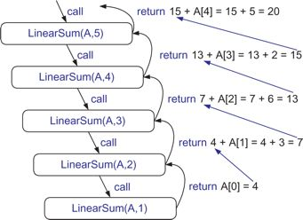
Analyzing Recursive Algorithms using Recursion Traces
Recursion trace for an execution of LinearSum(A,n) with input parameters A = [4,3,6,2,5] and n = 5
Dr.Ali Al-Ibrahim/WISE/IT

Slide 14
Linear recursion: Reversing an Array
Swap 1st and last elements, 2nd and second to last, 3rd and third to last, and so on
If an array contains only one element no need to swap (Base case)
Update i and j in such a way that they converge to the base case (i = j)
i
j
5
10
18
30
45
50
60
65
70
80
Dr.Ali Al-Ibrahim/WISE/IT

Slide 15
Linear recursion: Reversing an Array
void reverseArray(int A[], i, j){
if (i < j){
int temp = A[i];
A[i] = A[j];
A[j] = temp;
reverseArray(A, i+1, j-1)
}
// in base case, do nothing
}
Dr.Ali Al-Ibrahim/WISE/IT

Slide 16
Linear recursion: run-time analysis
Time complexity of linear recursion is proportional to the problem size
  Normally, it is equal to the number of times the function calls itself
In terms of Big-O notation time complexity of a linear recursive function/algorithm is O(n)
Dr.Ali Al-Ibrahim/WISE/IT

Slide 17
Recursion and stack management
A quick overview of stack
  Last in first out (LIFO) data structure
  Push operation adds new element at the top
  Pop operation removes the top element
Dr.Ali Al-Ibrahim/WISE/IT

Slide 18
What happens when a function is called?
The rest of the execution in “caller” is suspended
An activation record is created on stack, containing
  Return address (in the caller code)
  Current (suspended) status of the caller
Control is transferred to the “called” function
The called function is executed
Once the called function finishes its execution, the activation record is popped of, and the suspended activity resumes
  int a(int w)
  {
  return w+w;
  }
  int b(int x)
  {
  int z,y;
  z = a(x) + y;
  return z;
  }
Dr.Ali Al-Ibrahim/WISE/IT

Slide 19
What happens when a recursive function is called?
Except the fact that the calling and called functions have the same name, there is really no difference between recursive and non-recursive calls
      int f(int x){
      {
      int y;
      if(x==0)
      return 1;
      else{
      y = 2 * f(x-1);
      return y+1;
      }
      }
Dr.Ali Al-Ibrahim/WISE/IT

Slide 20
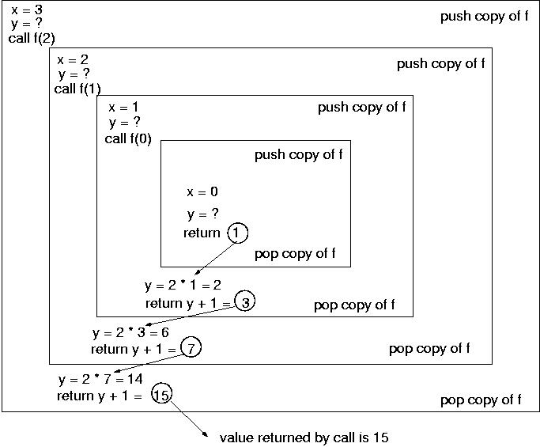
Recursion: Run-time stack tracing
2*f(2)
2*f(1)
2*f(0)
Let the function is called with parameter value 3, i.e. f(3)
=f(0)
      int f(int x){
      {
      int y;
      if(x==0)
      return 1;
      else{
      y = 2 * f(x-1);
      return y+1;
      }
      }
=f(1)
=f(2)
=f(3)
Dr.Ali Al-Ibrahim/WISE/IT

Slide 21
Binary recursion
Binary recursion occurs whenever there are two recursive calls for each non-base case
These two calls can, for example, be used to solve two similar halves of some problem
For example, the LinearSum program can be modified as:
    recursively summing the elements in the first half of the Array
    recursively summing the elements in the second half of the Array
    adding these two sums/values together
Dr.Ali Al-Ibrahim/WISE/IT

Slide 22
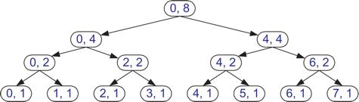
Binary Recursion: Array Sum
    A is an array, i is initialised as 0, and n is initialised as array size
int BinarySum(int A[], int i, int n){
if (n == 1)then // base case
return A[i];
else // recursive case I
return BinarySum(A, i, n/2) + BinarySum(A, i+n/2, n/2);
}
    Recursion trace for BinarySum, for n = 8 [Solve step-by-step]
Dr.Ali Al-Ibrahim/WISE/IT

Slide 23
Binary Search using Binary Recursion
    A is an array, key is the element to be found, LI is initialised as 0, and HI is initialised as array size - 1
int BinarySearch(int key, int A[], int LI, int HI){
if (LI > HI)then // key does not exist
return -1;
if (key == A[mid]) // base case
return mid;
else if (key < A[mid]) // recursive case I
BinarySearch(key, A, LI, mid - 1);
else // recursive case II
BinarySearch(key, A, mid + 1, HI);
}
Dr.Ali Al-Ibrahim/WISE/IT

Slide 24
Tail Recursion
An algorithm uses tail recursion if it uses linear recursion and the algorithm makes a recursive call as its very last operation
For instance, our reverseArray algorithm is an example of tail recursion
Tail recursion can easily be replaced by iterative code
  Embed the recursive code in a loop
  Remove the recursive call statement
Dr.Ali Al-Ibrahim/WISE/IT

Slide 25
Efficiency of recursion
Recursion is not efficient because:
  It may involve much more operations than necessary (Time complexity)
  It uses the run-time stack, which involves pushing and popping a lot of data in and out of the stack, some of it may be unnecessary (Time and Space complexity)
Both the time and space complexities of recursive functions may be considerably higher than their iterative alternatives
Dr.Ali Al-Ibrahim/WISE/IT

Slide 26
Recursion: general remarks
Use recursion when:
  The depth of recursive calls is relatively “shallow ضحل” compared to the size of the problem. (factorial is deep)
  The recursive version does about the same amount of work as the non-recursive version. (fibonacci does more work)
  The recursive version is shorter and simpler than the non-recursive solution (towers of hanoi)
Dr.Ali Al-Ibrahim/WISE/IT

Slide 27
Home work
Write a recursive function to compute first N Fibonacci numbers. Test and trace for N = 6
1 1 2 3 5 8
Write a recursive function to compute power of a number (x^{n}). Test and trace for 4⁵.
Dr.Ali Al-Ibrahim/WISE/IT

Slide 28
Computing Fibonacci Numbers
Fibonacci numbers are defined recursively:
    F₀ = 0
    F₁ = 1
    F_{i} = F_{i-1} ⁺ F_{i-2} for i > 1.
As a recursive algorithm (first attempt):
      Algorithm BinaryFib(k):
      Input: Nonnegative integer k
      Output: The kth Fibonacci number F_{k}
      if k = 1 then
      return k
      else
      return BinaryFib(k - 1) + BinaryFib(k - 2)
Using Recursion

Slide 29
Analyzing the Binary Recursion Fibonacci Algorithm
Let n_{k} denote number of recursive calls made by BinaryFib(k). Then
  n₀ = 1
  n₁ = 1
  n₂ = n₁ + n₀ + 1 = 1 + 1 + 1 = 3
  n₃ = n₂ + n₁ + 1 = 3 + 1 + 1 = 5
  n₄ = n₃ + n₂ + 1 = 5 + 3 + 1 = 9
  n₅ = n₄ + n₃ + 1 = 9 + 5 + 1 = 15
  n₆ = n₅ + n₄ + 1 = 15 + 9 + 1 = 25
  n₇ = n₆ + n₅ + 1 = 25 + 15 + 1 = 41
  n₈ = n₇ + n₆ + 1 = 41 + 25 + 1 = 67.
Note that the value at least doubles for every other value of n_{k}. That is, n_{k} > 2^{k/2}. It is exponential!
Using Recursion

Slide 30
A Better Fibonacci Algorithm
Use linear recursion instead:
    Algorithm LinearFibonacci(k):
    Input: A nonnegative integer k
    Output: Pair of Fibonacci numbers (F_{k}, F_{k-1})
    if k = 1 then
    return (k, 0)
    else
    (i, j) = LinearFibonacci(k - 1)
    return (i +j, i)
Runs in O(k) time.
Using Recursion

Slide 31

Towers of Hanoi
The puzzle starts with the disks in a neat stack in a ascending order of size on one rod, the smallest at the top, thus making a conical مخروطshape.
It involves moving n disks from tower A to tower B with the assistance of towerبرج C recursively, obeying the following rules:
  Only one disk may be moved at a time
  Each move consists of taking the upper disk from one of the rods and sliding it onto another rod, on top of the other disks that already be present on that rod.
  No disk may be placed on top of a smaller disk.

Slide 32
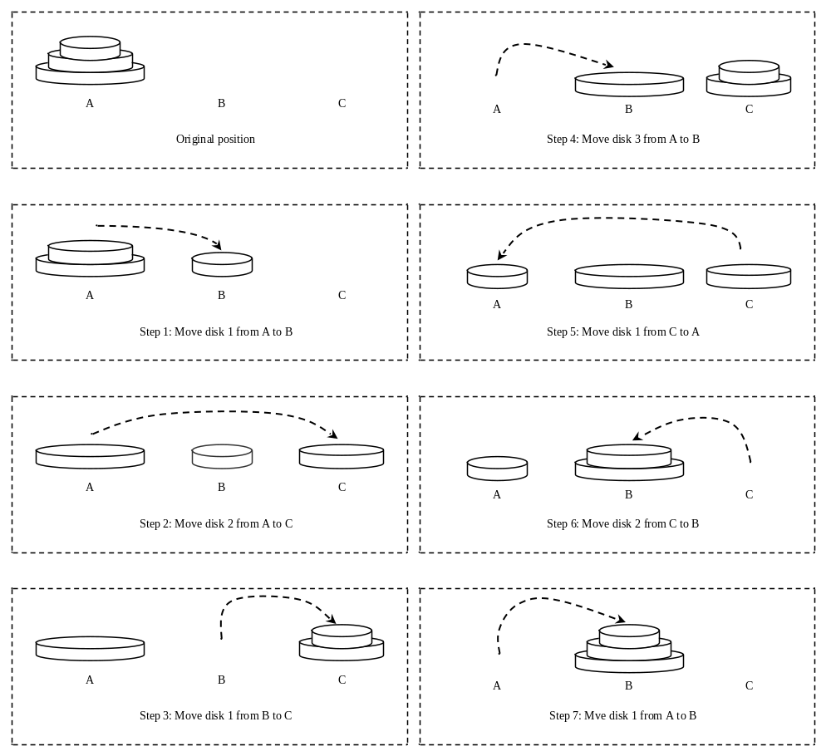
Towers of Hanoi, cont.

Slide 33
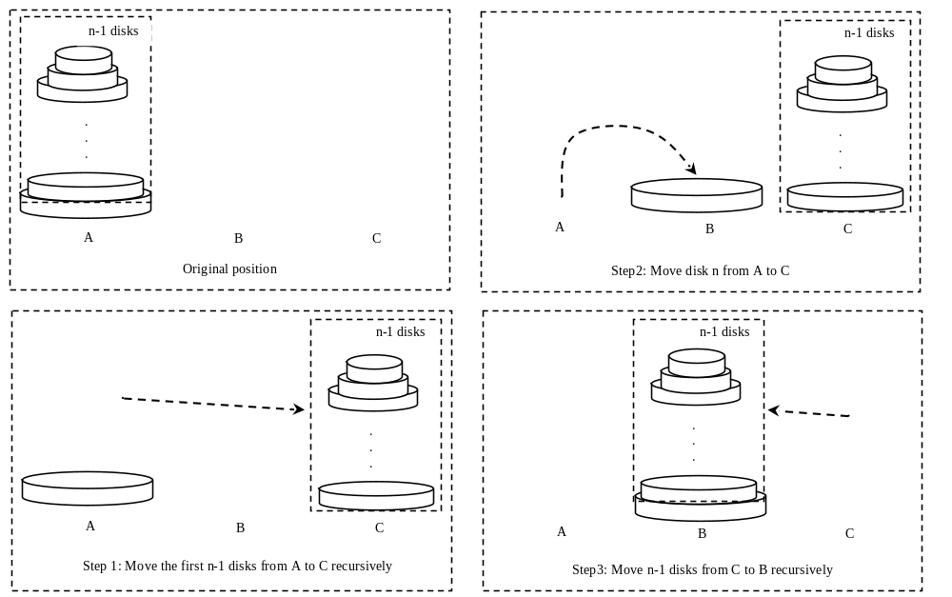
Solution to Towers of Hanoi
The Towers of Hanoi problem can be decomposed into three subproblems.
Step 2. Move disk n from A to B

Slide 34
Analyzing Towers of Hanoi
A suggested solution is:
  Move the first n – 1 disks from A to C with the assistance of tower B.
  Move disk n from A to B.
  Move n - 1 disks from C to B with the assistance of tower A.
Let T(n) denote the complexity for the algorithm that moves disks and c denote the constant time to move one disk, i.e., T(1) is c. So,

Slide 35
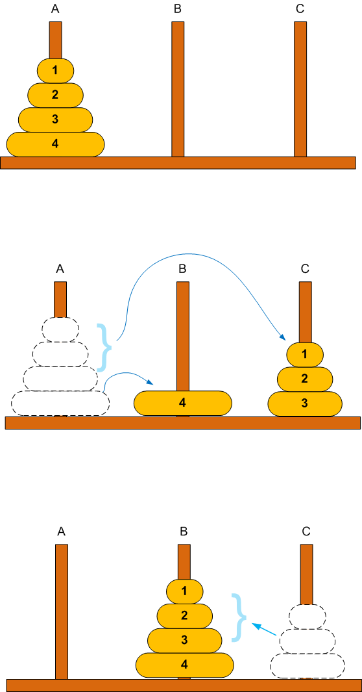
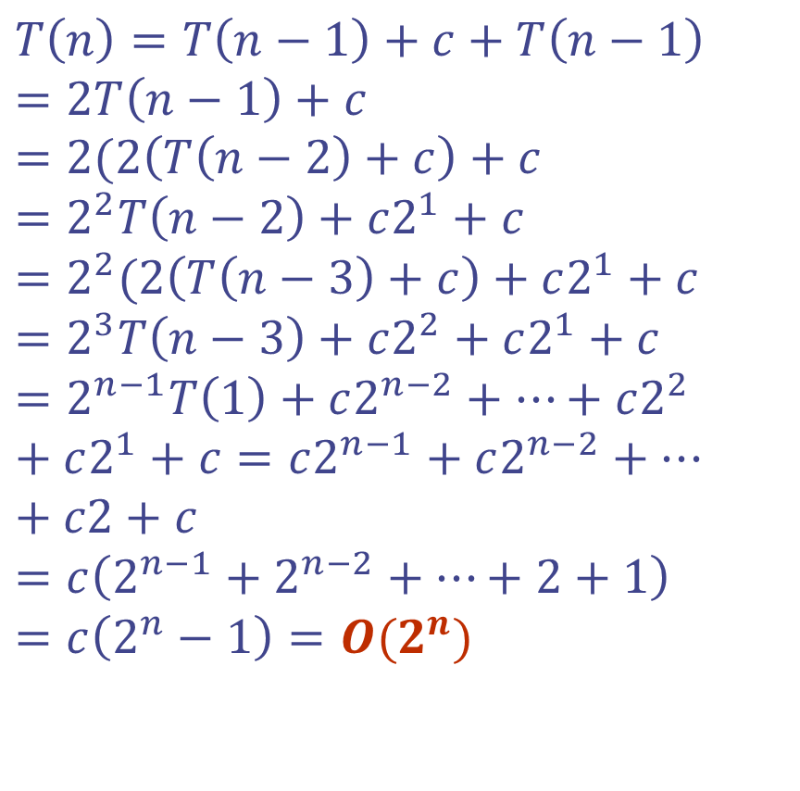
Analyzing Towers of Hanoi

Slide 36
Solution to Towers of Hanoi
public static void main(String[] args) {
int n = 4;
// moving disks from A to B using C as auxiliary tower
System.out.println("Towers of Hanoi. The moves are:");
moveDisks(n, 'A', 'B', 'C');
}
private static void moveDisks( int n, char fromTower, char toTower, char auxTower) {
if (n == 1)
System.out.println("Move disk " + n + " from "
+ fromTower + " to " + toTower);
else {
moveDisks(n-1, fromTower, auxTower, toTower);
System.out.println("Move disk " + n + " from "
+ fromTower + " to " + toTower);
moveDisks(n-1, auxTower, toTower, fromTower);
}

Slide 37
Outlook
Next week, we’ll discuss recursive sort
Dr.Ali Al-Ibrahim/WISE/IT

